Slide 1

Software Requirement
Ha Nguyen

Slide 2






Agenda
What is requirement?
Why do we have to analyze requirement?
Types of requirement
Issues while analyzing requirement
How to clarify requirement?
Resources related to requirement

Slide 3

What is requirement?
A constraint
A
service
A statement
A requirement is a statement…: this means that each requirement is a relatively short and
concise piece of information, expressed as a fact. It can be written as a sentence or can be
expressed using some kind of diagram. We will call a collection of requirements a requirements
document.
…an service of what the proposed system must do…: most requirements say something about
the tasks the system is supposed to accomplish. They do not describe the domain.
…a constraint on the system’s development…: requirements often specify the quality
levels required. They may also specify details such as the programming language to be used
if this is truly important to the customer. They should, however, avoid discussing incidental
aspects of the design

Slide 4

Why do we have to analyze requirement?
Requirement:
Create a Login form.
Explain: Read a unclear requirement above, you can understand what the customer want -> Need to analyze requirement to
be clear : move to next slide

Slide 5

Detect and resolve conflicts between requirements
Discover the bounds of the software and how it must interact with its environment
Elaborate system requirements to derive software requirements

Slide 6
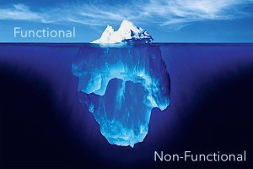
Types of requirement

Slide 7


Functional
Discuss the functionality required by the users from the system
Things that a system has to do related to business flow
Example:
Do a calculation: add, new, edit, delete functions
Make a report
Security: access right

Slide 8

Non-Functional
Quality constraint
Performance constraint
Design constraint
Environmental / platform constraint
Process constraint
Is a statement of how a system must behave;
Is a constraint upon system’s behaviour
Quality Constraint: Quality constraints reflects the quality attributes. These quality requirements constrain the design to meet specified levels of quality.
Maintainability and Enhancement, Reusability, Reliability
Performance constraints: Response time, Throughput, Utilization
Design constraints: Availability, Recovery from failure
Environmental/Platform constraints: Platform, Technology to be used
Process constraints: Development process to be used, Cost and delivery date

Slide 9
Quick question
Register form: functional or non-functional
Password has to contain at least 1 number, 1 special character
All labels are blue
Product feature has to be used easily
User name only contains letters & numbers
Payment feature has to perform quickly
Register feature need to have signature
Home Page is friendly
Register feature need to have: first name, last name, birthday, address

Slide 10
Summary
Functional Requirement
Non-functional Requirement
What the system shall do
What the system shall be
What the system does
How well the system does it
The things it should do
Measurements of how it does it

Slide 11

Issues while analyzing Requirement
Issues of scope
Issues of understanding
Issues of volatility
Issues of scope
The boundary of the system is ill-defined
The customers/users specify unnecessary technical detail that may confuse overall system objectives
Issues of understanding
The customers/users are not completely sure of what is needed
Have a poor understanding of the capabilities and limitations of their computing environment
Don’t have a full understanding of the problem domain, have trouble communicating needs to the system engineer
Omit information that is believed to be “obvious”
Specify requirements that conflict with the needs of other customers/users
Specify requirements that are ambiguous or un-testable.
Issues of volatility
The requirements change over time

Slide 12






How to clarify requirement?
PM/TL/BA present the SRS ( Software Requirement Specification) to members in the team
Issues of understanding
Self study related materials: Top-down approach
Clarify unclear item(s) using Q&A
Discuss with other members
Inform the PM/TL/BA
Explain: the meaning of these items above

Slide 13

Top-Down Approach
High level requirement: Use Case Diagram: a diagram that depicts the interactions between the
system and external systems and users.
Functional Requirement: use case/function details
Non-functional Requirement: ex. Performance requirement
General Requirement: ex. UI style

Slide 14
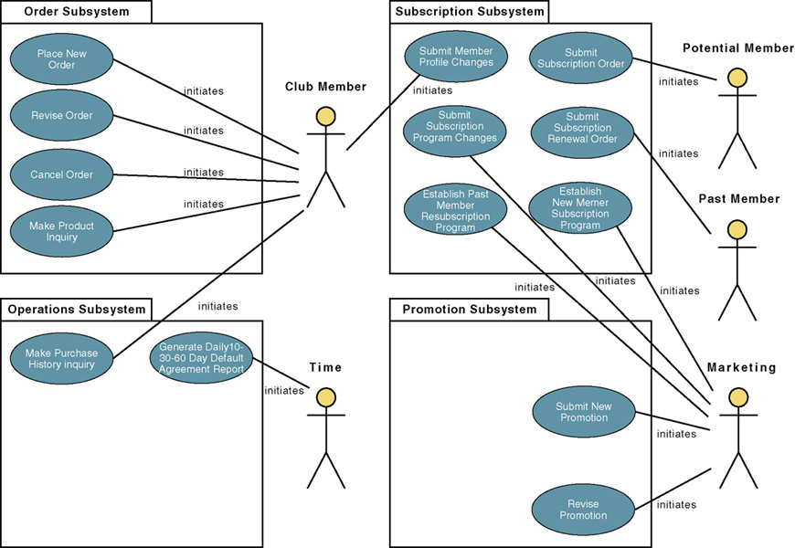
Use Case Diagram

Slide 15
Use Case/Function Details
Purpose: Brief overview of the use case, describing the main idea
Actor: Someone that interacts with the use case
Pre-condition: State(s) the system can be in before the use case starts
Trigger: Event that causes the use case to be initiated
Basic Flow: what happens and in what order when all is well
Alternative Flow: what happens and in what order when something goes wrong
Post-condition: State(s) the system can be in after the use case finishes
Business Rule: defines or constrains some aspect of business

Slide 16


Clarify unclear item(s) using Q&A
Why do we need Q&A?
Problems of understanding
Want for knowledge, must be ask
How to make Q&A effectively?
Identify the issue: unclear, get for more information, etc.
Check in all documents that customer supplied to make sure your question has not solved;
With technical question, check your team /group/company or ask “Google” to solve it before asking out
Give the cross-reference clearly, completely
Attach sample screen, demo, give your suggestions if any
Convert questions to Y/N or multiple-choice types if possible
In Q&A, give deadline that you want to receive the answer. It there is no answer until the deadline, what is impact?
Take the receiver to re-read the question before sending
Q&A focus:
Question for idea conveyed by words like: maybe, generally, etc.
What is the TBDs - Ask PL to remove all TBDs before handling to you for designing or coding
Conflict between requirements. Read the requirement matrix
Don’t make assumptions, just ask your PM, PL or BA
Follow up the Q&A
Track the discussion history for easier following up
If your question has not been replied or impacts to your task must be report to your PM, BA, or TL immediately
Keep in mind your manager/customer are very busy. So it is necessary to remind them about your pending issues daily, weekly. If not, your task will be impacted

Slide 17

Resource related to requirement
Quick question: Who need to be the clearest person in requirement? Why?
End-users
Managers
Owners
Customers of your customers
Operation engineers
Domain experts
Trade unions
Etc…

Slide 18
Corner for you: Clarify requirement by Q & A
We need a web page to show our products.
It can be divided into many pages when we have a lot of products.
Every product has information as: An image, Product ID, Product name, Price, Status.
User can click on every product and a popup will be showed with more detail about the product.
Your team: you have to make questions to customer to clarify the above requirement so that you can build a web page as customer’s needs.
The student will divide into many small team(5 students) to work together

Slide 19

Thanks for your listening

